Slide 1
Accelerators based on Intel® Movidius™ Vision Processing Unit
Notes:
After an optimized IR format model has been generated by MO, the next step is to implement the model into your computer vision application. This is where you will start to use the Inference Engine APIs.

Slide 2

Redefining the ai development kit
Intel® neural compute stick 2
Vision Processing Unit (VPU) | Intel® Movidius™ Myriad™ X VPU
Software Development Kit | Intel® Distribution of OpenVINO™ toolkit
Operating Software Support | Ubuntu* 16.04 or 18.04 LTS (64 bit), Windows® 10 (64 bit), CentOS* 7.4 (64 bit), macOS* 10.4.4, Raspbian*, and other via the open-source distribution of OpenVINO™ toolkit
Supported Framework | TensorFlow*, Caffe*, MXNet*, ONNX*, and PyTorch* / PaddlePaddle* via ONNX* conversion
Connectivity | USB 3.1 Type-A
Dimensions | 72.5mm X 27mm X 14mm
Operating Temperature | 0° - 40° C
Material Master Number | 964486
MSRP | $69 as of July 14th 2019
Notes:
Intel Neural Compute Stick 2, also known as Intel NCS2, is a Plug and Play Development Kit for Inferencing, it has the USB3.1 Type-A form-factor, features with one Intel Movidius Myriad X VPU, and good for prototyping with low-cost edge devices, such as Raspberry Pi* and other Arm* host devices. It supports Ubuntu* 16.04 or 18.04 LTS (64 bit), Windows 10 (64 bit), CentOS 7.4 (64 bit), macOS 10.4.4, Raspbian* OS. The supported frameworks follows the OpenVINO toolkit, and the supported layers can be found in OpenVINO’s documentation.

Slide 3
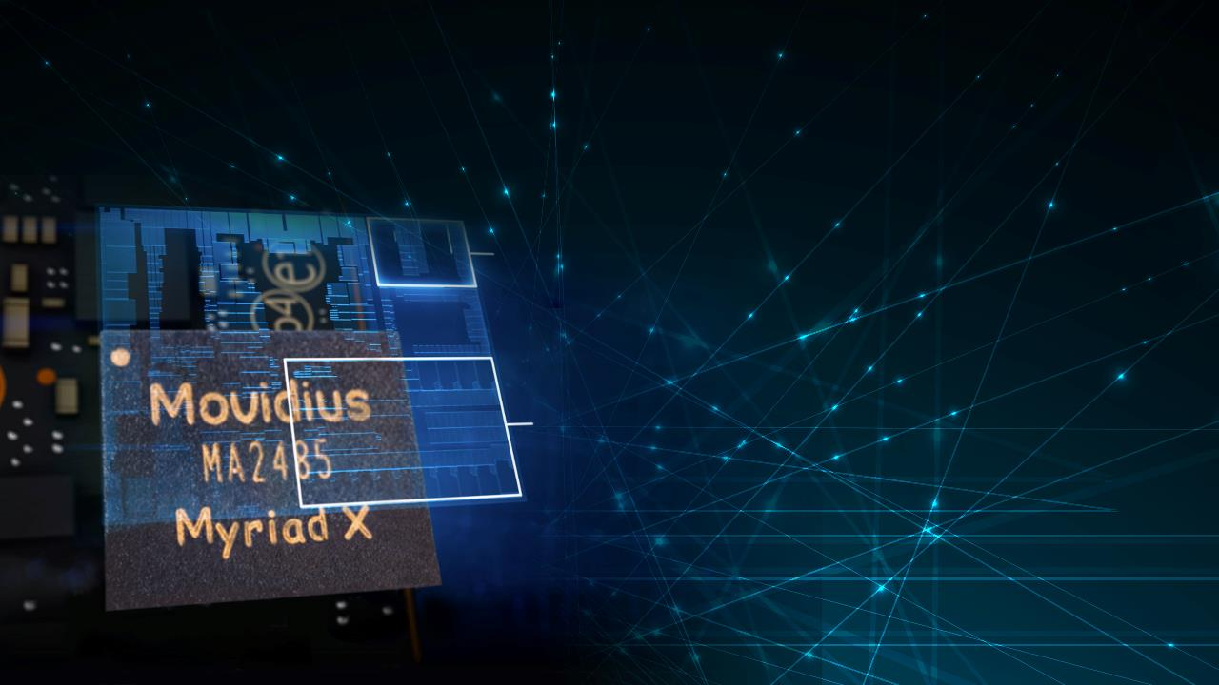
Next generation ai inference
Intel® Movidius™ myriad™ x vpu
Neural Compute Engine
An entirely new deep neural network (DNN) inferencing engine that offers flexible interconnect and ease of configuration for on-device DNNs and computer vision applications
16 SHAVE Cores
VLIW (DSP) programmable processors are optimized for complex vision & imaging workloads
Notes:
Inside the NCS2, the architecture of the Intel Movidius Myriad X VPU is shown on this slide. The key components of Myriad X VPU are the Neural Compute Engine and 16 Programmable SHAVE Cores. The neural compute engine is the dedicated hardware accelerator for running on-device deep neural network interfacing directly with other components via the intelligent memory fabric. The programmable SHAVE Cores can be used to run traditional computer vision workloads or can complement the Neural Compute Engine by running the layer types not supported out of the box. The VPU also features a hardware-based encoder for up to 4K video resolution and includes a new stereo depth block that is capable of processing dual 720p feeds at up to 180Hz. As a result, the VPU can be used as a single-chip solution for all imaging, computer vision, and CNN workloads.

Slide 4


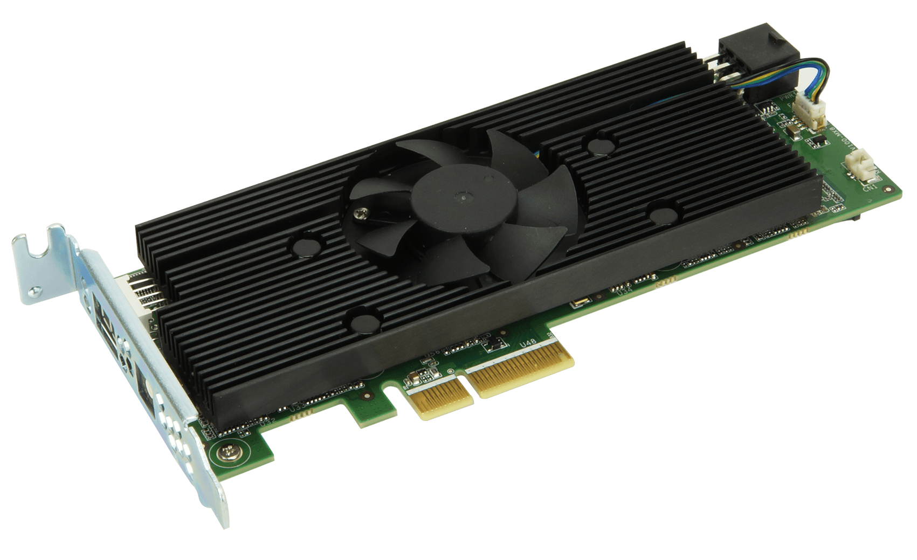








Examples of Intel® Vision Accelerator Design Products
Accelerators based on Intel® Movidius™ VPU
Example card
based on
Vision Accelerator Designs
1 Intel® Movidius™ VPU
2 Intel® Movidius™ VPUs
8 Intel® Movidius™ VPUs
Interface
M.2, Key E
miniPCIe**
PCIe x4
Currently manufactured by*
**Other names and brands may be claimed as the property of others
Software tools
INTEL® DISTRIBUTION OF OPENVINO™ TOOLKIT
Develop NN Model; Deploy across Intel® CPU, GPU, VPU, FPGA; Leverage common algorithms
Click here for Latest Publicly Posted Benchmarks
Click here for Programing Guide for Use with Intel® Distribution of OpenVINO toolkit
Notes:
Here are some accelerators based on Intel Movidius Myriad X VPU, they are available on the market, manufactured by Intel partners. These accelerators implement one or more VPUs on a single modular board, as you can see from here, on the left, it is an M.2 form-factor board with one VPU on it, in the middle, a mini-PCIe interfaced board with 2 VPUs, and on the right hand is a standard PCIe x4 card contains 8 VPUs.

